Slide 1
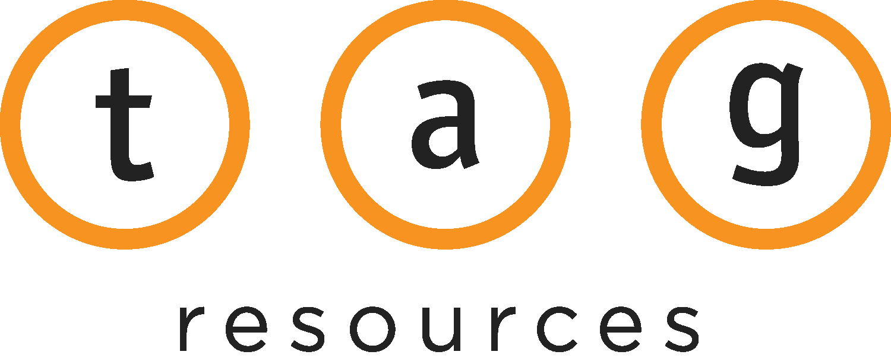

Slide 2
TAG Facts
Fiduciary Outsourcing since 2002
Transamerica’s largest Exchange product
Largest “end to end” 401K in America
Administrative Fiduciary
Investment Fiduciary
Largest provider of fiduciary protection
3(16) – TAG
3(38) - Mercer

Slide 3
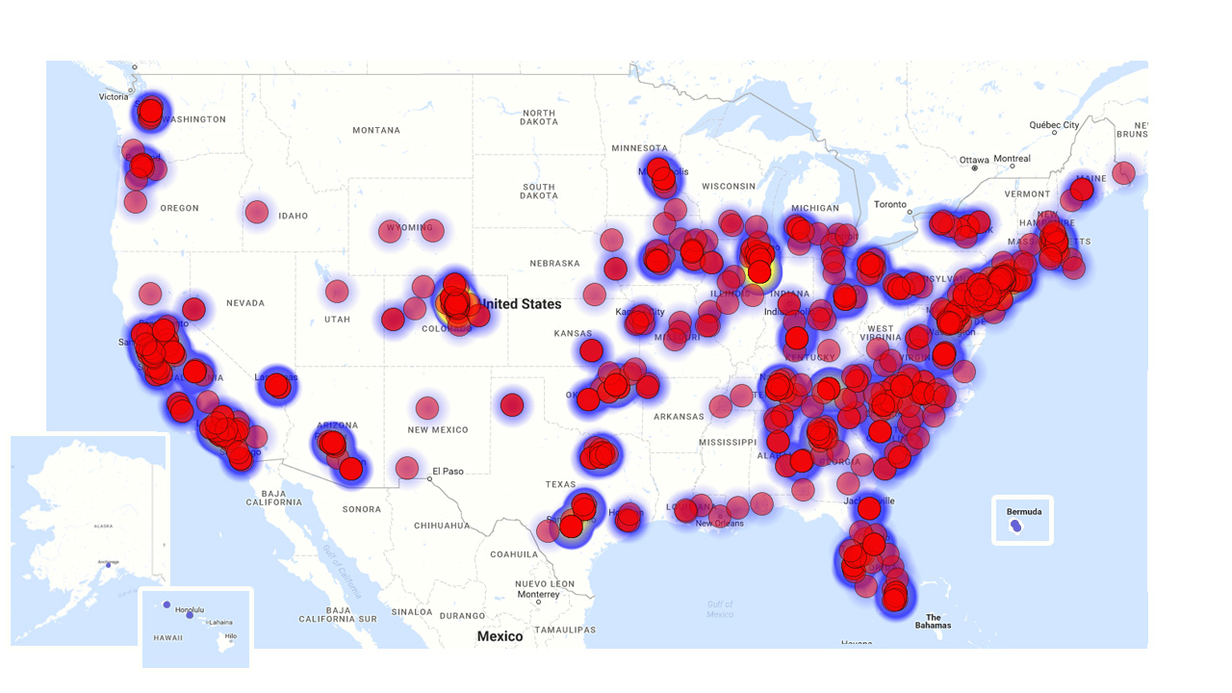
National Presence

Slide 4
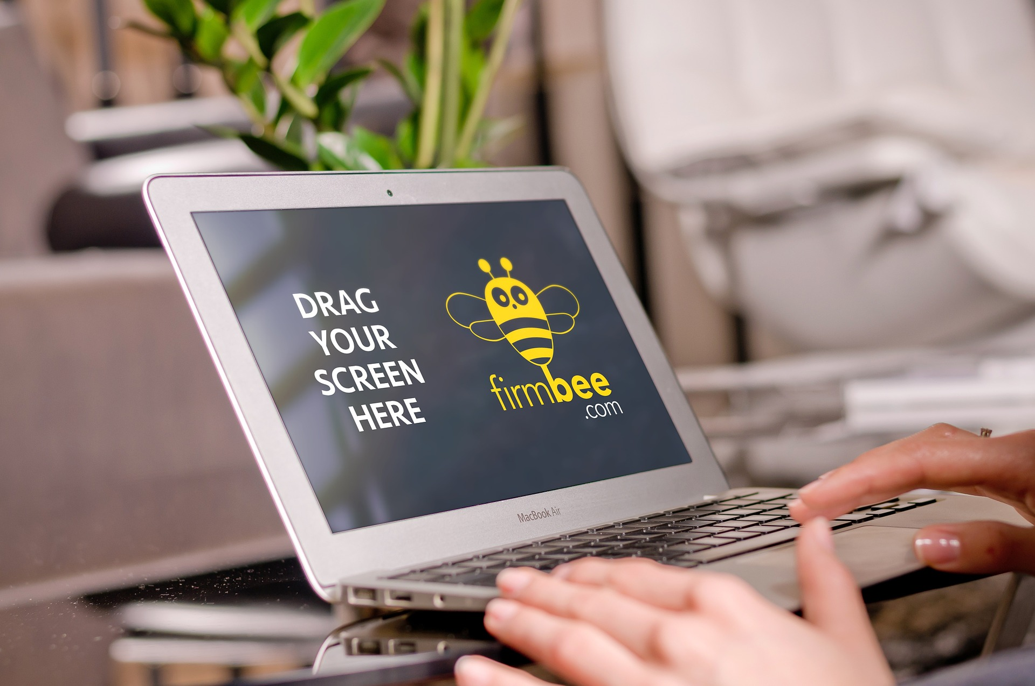
Why Does a Business Want a 401k?
Increase administrative tasks
Increase governmental regulation scrutiny
Increase liability for yourself and your company

Slide 5
The Real Reasons
Add a valuable company benefit?
Allow owners/managers and their employees to retire comfortably?
Aid in recruitment and retention?

Slide 6
Administrative Requirements
Sponsor Responsibilities without TAG
Signing & Filing Form 5500
Employee Communications
404(a)(5)
404(c)
408(b)(2)
Benefit Payments
Blackout Periods
Summary Plan Description
Document Requests
Legal Process
Retirement Plan Tax Issues
Pre-Populated Year-End
Questionnaire
Select and Monitor Investment Menu
Quarterly Investment Meetings
Spousal Consent
Filing of Form 8955
Error Correction
Rate Change Reports
Distribution Reports
Loan Reports
Eligibility Reports
QDRO Reports
402(g) Limit Reports
Lost Earnings Calculations
Final Census
Trustee Duties
QDRO Determinations
Upload Payroll Files
Provide Year End Data
Plan Design
Work With DOL or IRS for Issue Resolution
Sponsor Responsibilities without TAG

Slide 7
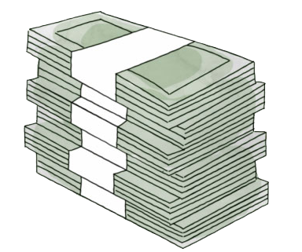
Government Regulation
Failure of DOL audits
67.7%
Average Fine
$280K

Slide 8
“Tsunami of Lawsuits” Forbes Magazine
Fiduciary Liability
Errors in Administration and Investments
Personal Liability
Large Employers
Lockheed Martin
Edison International
Smaller Employers
LaMettry’s Body Shop
Minnesota

Slide 9
What If?
You could accomplish all that you want to do without the things you don’t want?

Slide 10
You Can’t
Not with typical 401k plans
Most plans in America are “low functioning”, basic 401k plans

Slide 11
YOU CAN WITH TAG Resources
An “end to end” provider, not a “low functioning” provider
You can outsource all the negatives to TAG
You can keep all the positives

Slide 12
Administrative Requirements
Sponsor Responsibilities without TAG
Signing & Filing Form 5500
Employee Communications
404(a)(5)
404(c)
408(b)(2)
Benefit Payments
Blackout Periods
Summary Plan Description
Document Requests
Legal Process
Retirement Plan Tax Issues
Pre-Populated Year-End
Questionnaire
Select and Monitor Investment Menu
Quarterly Investment Meetings
Spousal Consent
Filing of Form 8955
Error Correction
Rate Change Reports
Distribution Reports
Loan Reports
Eligibility Reports
QDRO Reports
402(g) Limit Reports
Lost Earnings Calculations
Final Census
Trustee Duties
QDRO Determinations
Upload Payroll Files
Provide Year End Data
Plan Design
Work With DOL or IRS for Issue Resolution
Sponsor Responsibilities without TAG

Slide 13
Optimize Efficiency/Ease of Administration
WITH TAG
Upload Payroll Files
Monitor TAG
Provide Year End Data
TAG
performs
99%
of Administrative
Tasks

Slide 14
Government Regulation
Failure of DOL audits
67.7%
Average Fine
$280K

Slide 15
Government Regulation
Failure of DOL audits
67.7%
Zero
Failures
Zero
Fines
Average Fine
$280K

Slide 16
“Tsunami of Lawsuits” Forbes Magazine
Fiduciary Liability
Errors in Administration and Investments
Personal Liability
Large Employers
Lockheed Martin
Edison International
Smaller Employers
LaMettry’s Body Shop
Minnesota

Slide 17
“Tsunami of Lawsuits” Forbes Magazine

Fiduciary Liability
Errors in Administration and Investments
Personal Liability
Large Employers
Lockheed Martin
Edison International
Smaller Employers
LaMettry’s Body Shop
Minnesota
Zero
Lawsuits

Slide 18
Cost
Comparable on plan level
Much lower when considering
Repurposing of resources
Risk of audit failure
Risk of lawsuit
Low cost annual audit if your company has over 100 employees
Lowest cost plan available on the market

Slide 19
How do we do it?
TAG is the largest “end to end” 401k provider in the US with over 100,000 participants
Gold Standard in the industry for fiduciary outsourcing
Power of aggregation $1B vs $10M
Transamerica is one of the largest record keepers in the US with over 40 industry awards for excellence
Mercer is one of the largest financial services companies globally with AUM of over $150B and 5,900 investment managers

Slide 20
Are you for the best 401k in America?
Sign the TAG Letter of Intent.
A TAG person will be in touch to discuss required documents and answer any questions.

